Slide 1
DATA STRUCTURES
EXAMPLES AND DETAILS

Slide 2
TABLE OF CONTENTS
Overview
Data types
Examples
Array
Associative array
Record (struct)
Union
Tagged union
Set
Graph and Tree
Class
Abstract data types

Slide 3
DATA STRUCTURES
Overview

Slide 4
DATA STRUCTURES - OVERVIEW
In computer science, a data structure is a particular way of organizing data in a computer so that it can be used efficiently

Slide 5
DATA STRUCTURES - OVERVIEW
Data structures can implement one or more particular abstract data types (ADT), which are the means of specifying the contract of operations and their complexity.
In comparison, a data structure is a concrete implementation of the contract provided by an ADT.

Slide 6
DATA STRUCTURES - OVERVIEW
Different kinds of data structures are suited to different kinds of applications, and some are highly specialized to specific tasks.
For example, relational databases most commonly use B-tree indexes for data retrieval, while compiler implementations usually use hash tables to look up identifiers.

Slide 7
DATA STRUCTURES - OVERVIEW
Data structures provide a means to manage large amounts of data efficiently for uses such as large databases and internet indexing services.
Usually, efficient data structures are key to designing efficient algorithms.
Some formal design methods and programming languages emphasize data structures, rather than algorithms, as the key organizing factor in software design.
Storing and retrieving can be carried out on data stored in both main memory and in secondary memory.

Slide 8
DATA STRUCTURES - OVERVIEW
Data structures are generally based on the ability of a computer to fetch and store data at any place in its memory, specified by a pointer - a bit string, representing a memory address, that can be itself stored in memory and manipulated by the program.
Thus, the array and record data structures are based on computing the addresses of data items with arithmetic operations; while the linked data structures are based on storing addresses of data items within the structure itself.
Many data structures use both principles, sometimes combined in non-trivial ways (as in XOR linking).

Slide 9
DATA STRUCTURES - OVERVIEW
The implementation of a data structure usually requires writing a set of procedures that create and manipulate instances of that structure.
The efficiency of a data structure cannot be analyzed separately from those operations.
This observation motivates the theoretical concept of an abstract data type, a data structure that is defined indirectly by the operations that may be performed on it, and the mathematical properties of those operations (including their space and time cost).

Slide 10
DATA STRUCTURES
Data types

Slide 11
DATA TYPES - PRIMITIVE TYPES
Boolean, true or false
Character
Floating-point, single-precision real number values
Double, a wider floating-point size
Integer, integral or fixed-precision values
Enumerated type, a small set of uniquely-named values

Slide 12
COMPOSITE TYPES
Array
Record (also called tuple or struct)
Union
Tagged union (also called variant, variant record, discriminated union, or disjoint union)

Slide 13
ABSTRACT DATA TYPES
Container - collections of other objects
List (sequence) - ordered sequence of values, where the same value may occur more than once.
Associative array (dictionary) – ADT composed of a collection of (key, value) pairs
Multimap (multihash) – ADT in which more than one value may be associated with and returned for a given key
Set - that can store certain values, without any particular order, and no repeated values.
Multiset - similar to a set but allows repeated ("equal") values (duplicates).
Stack -
Queue -
Double-ended queue -
Priority queue -
Tree -
Graph -

Slide 14
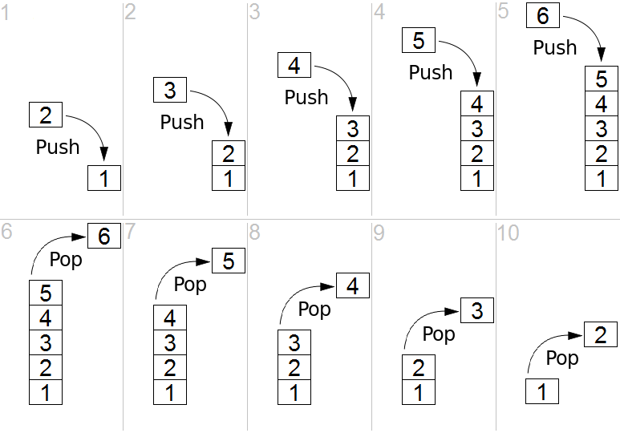
STACK (ABSTRACT DATA TYPE)
In computer science, a stack is an abstract data type that serves as a collection of elements, with two principal operations: push, which adds an element to the collection, and pop, which removes the most recently added element that was not yet removed.
The order in which elements come off a stack gives rise to its alternative name, LIFO (for last in, first out).
Additionally, a peek operation may give access to the top without modifying the stack.

Slide 15
QUEUE (ABSTRACT DATA TYPE)
In computer science, a queue is a particular kind of abstract data type or collection in which the entities in the collection are kept in order and the principal (or only) operations on the collection are the addition of entities to the rear terminal position, known as enqueue, and removal of entities from the front terminal position, known as dequeue.
This makes the queue a First-In-First-Out (FIFO) data structure.
Often a peek or front operation is also entered, returning the value of the front element without dequeuing

Slide 16
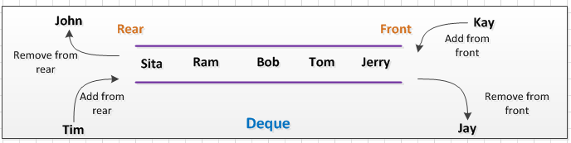
DOUBLE-ENDED QUEUE
dequeue, often abbreviated to deque, pronounced deck) is an abstract data type that generalizes a queue, for which elements can be added to or removed from either the front (head) or back (tail).

Slide 17
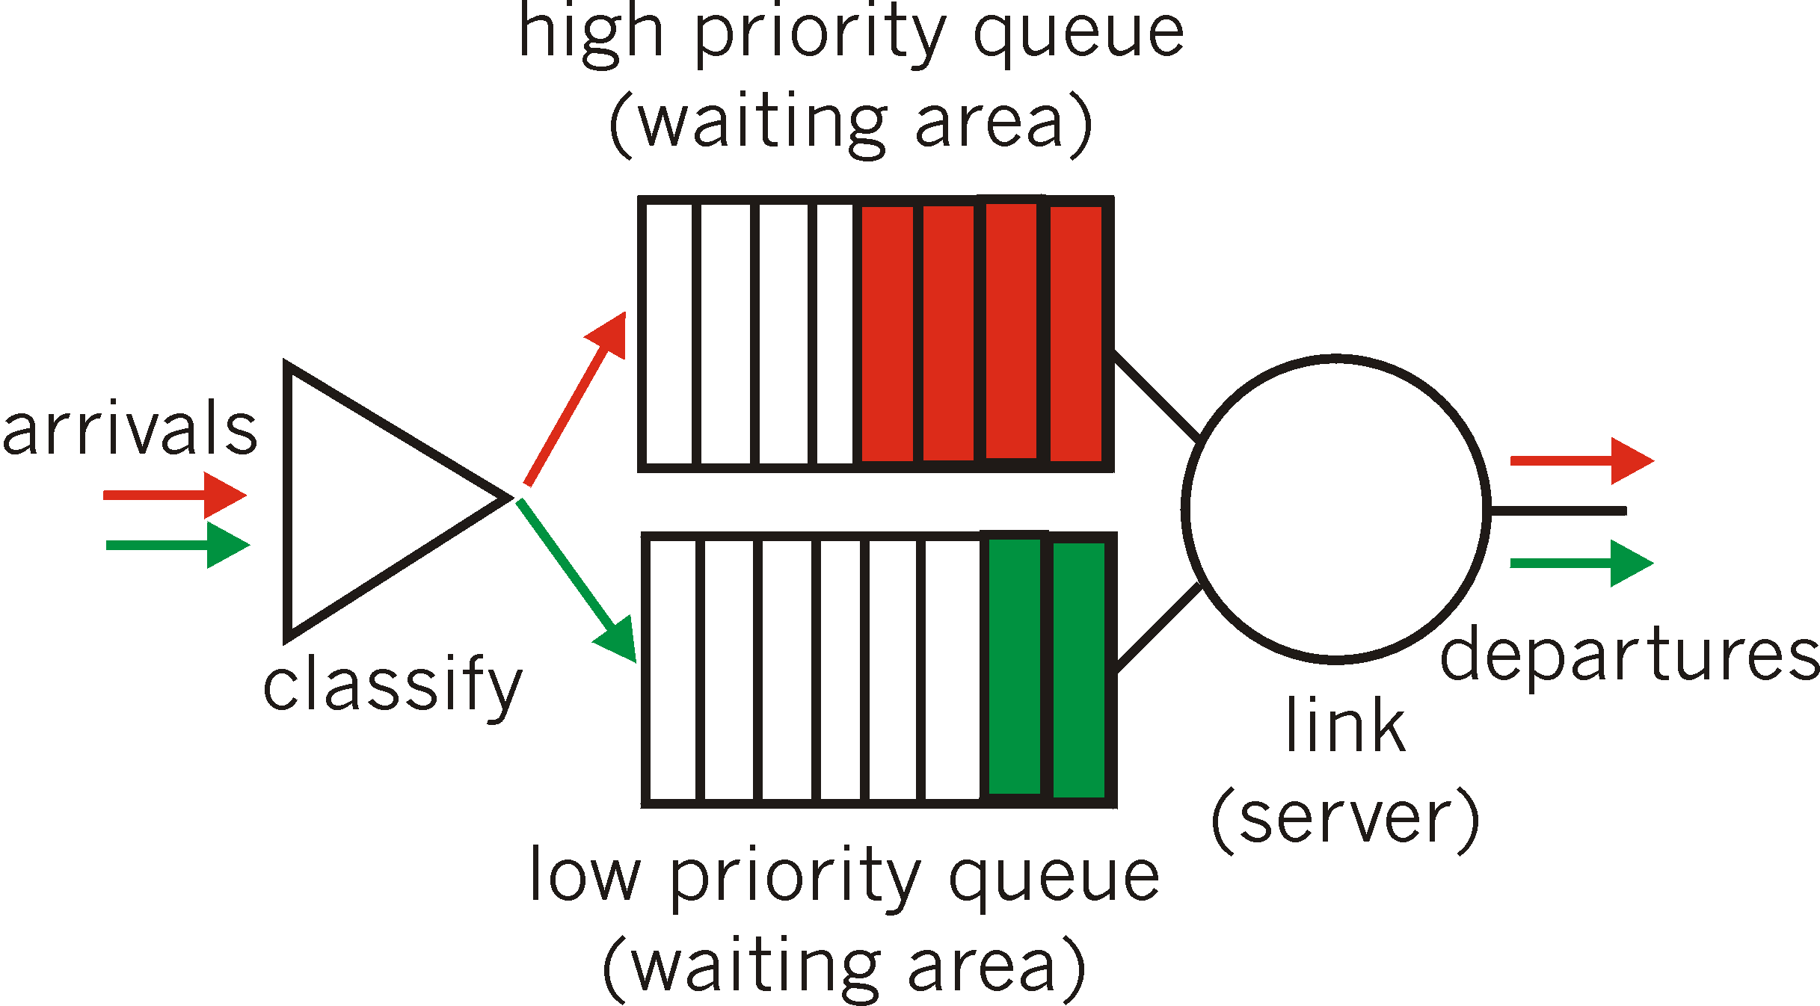
PRIORITY QUEUE
In computer science, a priority queue is an abstract data type which is like a regular queue or stack data structure, but where additionally each element has a "priority" associated with it. In a priority queue, an element with high priority is served before an element with low priority. If two elements have the same priority, they are served according to their order in the queue.

Slide 18
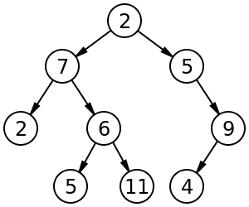
TREE (DATA STRUCTURE)
In computer science, a tree is a widely used abstract data type (ADT)—or data structure implementing this ADT—that simulates a hierarchical tree structure, with a root value and subtrees of children with a parent node, represented as a set of linked nodes.

Slide 19
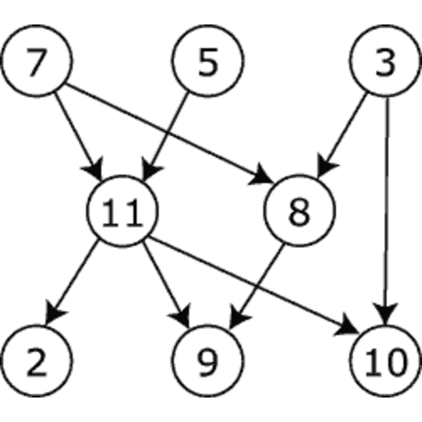
GRAPH (ABSTRACT DATA TYPE)
A graph data structure consists of a finite (and possibly mutable) set of vertices or nodes or points, together with a set of unordered pairs of these vertices for an undirected graph or a set of ordered pairs for a directed graph.
A graph data structure may also associate to each edge some edge value, such as a symbolic label or a numeric attribute (cost, capacity, length, etc.).

Slide 20
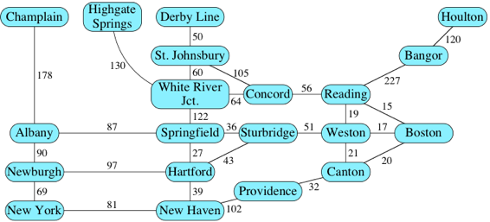
GRAPH & WEIGHTS

Slide 21
ARRAY
An array (also called list) is a number of elements in a specific order, typically all of the same type. Elements are accessed using an integer index to specify which element is required (although the elements may be of almost any type). Typical implementations allocate contiguous memory words for the elements of arrays (but this is not always a necessity). Arrays may be fixed-length or resizable.

Slide 22
ASSOCIATIVE ARRAY
An associative array (also called dictionary or map) is a more flexible variation on an array, in which name-value pairs can be added and deleted freely. A hash table is a common implementation of an associative array.

Slide 23
RECORD
A record (also called tuple or struct) is an aggregate data structure. A record is a value that contains other values, typically in fixed number and sequence and typically indexed by names. The elements of records are usually called fields or members.

Slide 24
UNION
A union is a data structure that specifies which of a number of permitted primitive types may be stored in its instances, e.g. float or long integer. Contrast with a record, which could be defined to contain a float and an integer; whereas in a union, there is only one value at a time. Enough space is allocated to contain the widest member datatype.

Slide 25
TAGGED UNION
A tagged union (also called variant, variant record, discriminated union, or disjoint union) contains an additional field indicating its current type, for enhanced type safety.

Slide 26
SET
A set is an abstract data structure that can store specific values, in no particular order and with no duplicate values.

Slide 27
GRAPH AND TREE
A graph and a tree are linked abstract data structures composed of nodes. Each node contains a value and one or more pointers to other nodes arranged in a hierarchy. Graphs can be used to represent networks, while variants of trees can be used for sorting and searching, having their nodes arranged in some relative order based on their values.

Slide 28
CLASS
A class is a data structure that contains data fields, like a record, as well as various methods which operate on the contents of the record. In the context of object-oriented programming, records are known as plain old data structures to distinguish them from classes.

Slide 29
C# Data structures

Slide 30
C# Array
The perhaps simplest and most common data structure is the array. A C# array is basically a list of objects. Its defining traits are that all the objects are the same type (in most cases) and there is a specific number of them. The nature of an array allows for very fast access to elements based on their position within the list (otherwise known as the index). A C# array is defined like this:
[object type][] myArray = new [object type][number of elements]
Examples
int[] myIntArray = new int[5];
int[] myIntArray2 = { 0, 1, 2, 3, 4 };

Slide 31
C# Array
Looping through array
int[] myIntArray = { 10, 11, 12, 13, 14 };
for (int index = 0; index < myIntArray.Length; index++)
{
Console.WriteLine(myIntArray[index]);
}

Slide 32
ArrayList
The C# data structure, ArrayList, is a dynamic array. What that means is an ArrayList can have any amount of objects and of any type. This data structure was designed to simplify the processes of adding new elements into an array. Under the hood, an ArrayList is an array whose size is doubled every time it runs out of space. Doubling the size of the internal array is a very effective strategy that reduces the amount of element-copying in the long run. We won't get into the proof of that here. The data structure is very simple to use:
The downside to the ArrayList data structure is one must cast the retrieved values back into their original type:
ArrayList myArrayList = new ArrayList();
myArrayList.Add(56);
myArrayList.Add("String");
myArrayList.Add(new Form());

Slide 33
ArrayList
Looping through ArrayList
ArrayList myArrayList = new ArrayList();
myArrayList.Add(56);
myArrayList.Add("String");
myArrayList.Add(new DateTime());
foreach (var item in myArrayList)
{
Console.WriteLine(item);
}

Slide 34
List<T>
The List C# data structure was introduced in the .NET Framework 2.0 as part of the new set of generic collections. List is the generic version of ArrayList, which means that it behaves exactly the same way, but within a specified type. So for example, a List of integers would work as follows:
Since the List<> object is tailored to a specific data type, there is no need to cast when retrieving values:
This results in much cleaner, and in my times, faster code. This is especially true when working with primitive types. You should always use List over ArrayList.
List<int> intList = new List<int>();
intList.Add(45);
intList.Add(34);
int listValue = intList[0];

Slide 35
Stack<T> and Queue<T>
Stack
https://www.tutorialsteacher.com/csharp/csharp-stack
Queue
https://www.tutorialsteacher.com/csharp/csharp-queue

Slide 36
Task 1
Create two arrays containing data as follow:
Array 1 - Names
Array 2 - Birth dates
Create console app which is asking for specific index and returns a sentence like:
John Smith’s birthday is in beginning [mid, end] of March

Slide 37
Task 2
Write a C# program to find the longest word in a string. Test Data: “Write a C# Sharp Program to display the following pattern using the alphabet.” Sample Output: “following”

Slide 38
Task 3
Write a C# program to reverse the words of a sentence. Original String: “Display the pattern like pyramid using the alphabet.” Reverse String: “alphabet. the using pyramid like pattern the Display”

Slide 39
Homework
Array
Declare new array
Add 10 items into array
Check if specific item exists into the array
Display all items from the array
Stack – same functionality as with Array
Queues – same functionality as with Array
List<T> - same functionality as with Array

Slide 40
MATERIALS
https://en.wikipedia.org/wiki/Data_structure
https://en.wikipedia.org/wiki/List_of_data_structures
https://en.wikipedia.org/wiki/Abstract_data_type
https://en.wikipedia.org/wiki/Linked_data_structure
https://en.wikipedia.org/wiki/Concurrent_data_structure
http://www.vcskicks.com/csharp_data_structures.php
https://dotnetcademy.net/CSharp/Beginner
https://www.tutorialsteacher.com/csharp/csharp-stack

